Slide 1


Netflix Movies and
TV Shows Clustering
Netflix offers a large selection of movies and TV shows, but how are they grouped? In this presentation, we explore the clustering techniques used to organize content on the platform.
By - Vibhuti Gupta
Rudraashish Sengupta

Slide 2


Contents:
Introduction.
Dataset Preview.
Exploratory Data Analysis.
Data Preprocessing.
Creating Clusters.
Conclusions.

Slide 3

Introduction:
Netﬂix is a media distribution company. It started with DVD distribution via mail, but has evolved substantially over the course of its existence. Today, Netﬂix is focused on streaming video. Some of its content is licensed, and some of the content is produced in-house.
Netﬂix originally focused on movies, but today television shows are probably the more common format. Netﬂix works on a subscription model, where users get unlimited access to content with a paid subscription.
With more than 83 million subscribers and presence in more than 190 countries, Netflix is the most popular Internet television network in the world. Its users watch more than 125 million hours of TV and movie content daily, including original series, documentaries, and feature films. On almost any screen that is linked to the Internet, members can watch as much as they want, whenever and wherever. Without interruptions or obligations, members can play, pause, and resume watching at any time

Slide 4
Problem Statement
This dataset consists of tv shows and movies available on Netflix as of 2019. The dataset is collected from Flexible which is a third-party Netflix search engine.
In 2018, they released an interesting report which shows that the number of TV shows on Netflix has nearly tripled since 2010. The streaming services number of movies has decreased by more than 2,000 titles since 2010, while its number of TV shows has nearly tripled. It will be interesting to explore what all other insights can be obtained from the same dataset.

Slide 5
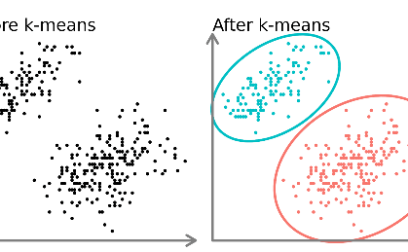
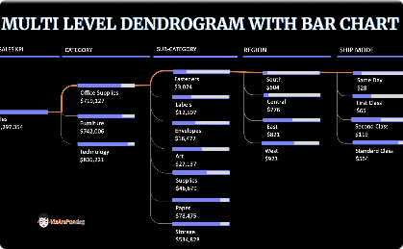
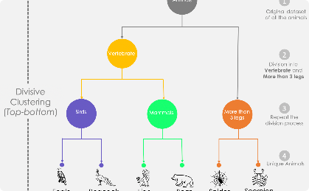
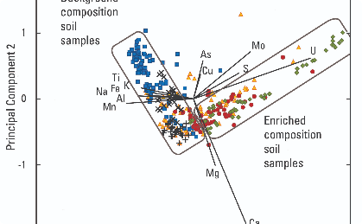
Clustering and Data Analysis Techniques
KMeans Algorithm
Dendrogram
Hierarchical Clustering
Principal Component Analysis
We used the KMeans algorithm to group similar shows together based on their features and meta-data.
We analyzed a dendrogram that displays similar shows on the same branch, we deduced the optimal number of clusters to be seven.
We utilized hierarchical cluster analysis to cluster short movies and TV shows that have minimal feature information.
We implemented PCA technique to reduce the dimensionality of the features in our dataset, preserving essential characteristics.

Slide 6
DATA PIPELINE:
Analyze Data: In this initial step we went to look for different features available and tried to understand the data. During this stage, we looked for the shape of data, data types of each feature, statistical summary etc.
EDA: EDA or Exploratory Data Analysis is the critical process of performing the initial investigation on the data. So, through this we have observed certain trends and dependencies and drawn certain conclusions from the dataset that will be useful for further processing.
Data Cleaning: Checked duplicated values present in the dataset. After that comes the null value and outlier detection and treatment. For the null values imputation we simply replace with empty string and drop some of the null rows then analyze outlier and handling.
Textual Data Preprocessing: During this stage, cluster the data based on the attributes: director, cast, country, genre, rating and description. Data preprocessing include Remove all stop words and punctuation marks, convert all textual data to lowercase. Stemming to generate a meaningful word out of corpus of words. Tokenization of corpus and Word vectorization. We used Principal Component Analysis (PCA) to handle the curse of dimensionality.
Clusters Implementation: Use K-Means and Agglomerative Hierarchical clustering algorithms to cluster the movies, obtain the optimal number of clusters using different techniques.
Build Content Based Recommendation System: A content-based recommender system was built using the similarity matrix obtained after using cosine similarity. This recommender system will display 10 recommendations to the user based on the type of movie/show they watched.

Slide 7
Overview of the Resulting Clusters
Action and Adventure
Comedies
Clustered content includes shows with car chases, gunfights and explosions. e.g Narcos, The Umbrella Academy
This cluster consists of witty shows that make you laugh. e.g Arrested Development, Trailer Park Boys
Documentaries
Dramas
Showcasing real-life stories and current events. e.g Dirty Money, Making a Murderer
Showcasing raw emotions, authentic life struggles and conflicts. e.g Stranger Things, Peaky Blinders

Slide 8
ATTRIBUTE INFORMATION:
DATASET SUMMARY:
This dataset consist of movie and TV shows available on Netflix till 2020.
The dataset contained about 7787 records and 12 attributes.
Most of the features are Present in textual format.
Dataset contains two type of content one is Movie and another one is TV show.
Show Id : Unique ID for every Movie/Show
Type : Identifier - Movie/Show
Title : Title of the Movie/Show
Director : Director of the Movie/Show
Cast : Actors involved in the Movie/Show
Country : Country where the Movie/Show was produced
Date Added : Date it was added on Netflix
Release Year : Actual Release year of the Movie/Show
Rating : TV Rating of the Movie/Show
Duration : Total Duration - in minutes or number of seasons
Listed In : Genre
Description : The Summary description

Slide 9
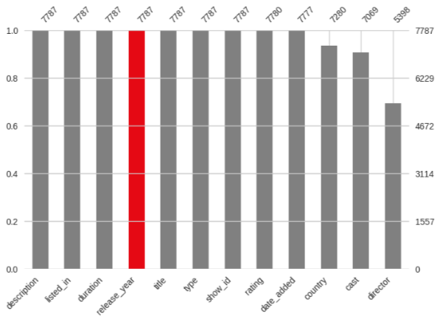
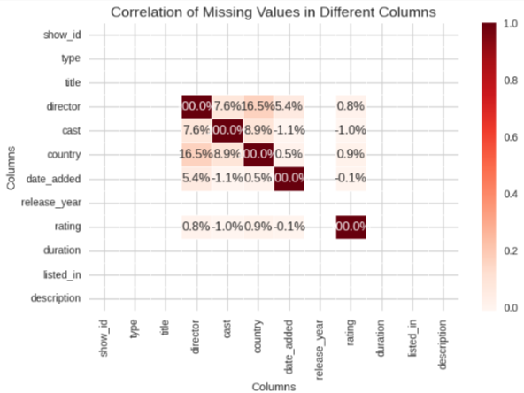
Null Values Treatment:
Null values present in the director, cast, country, date_added and rating column.
All the data that we have is related to each specific movie. So, we can't impute any null values with using any method. Also, we don't want to lose any data since the data size is small for that reason.
The null values in the director, cast, and country attributes can be replaced with 'empty string’.
Small amount of null value percentage present in rating and date_added column, if we drop these nan values it will not affect that much while building the model. So, we simply drop the nan value present in rating and date_added columns.

Slide 10
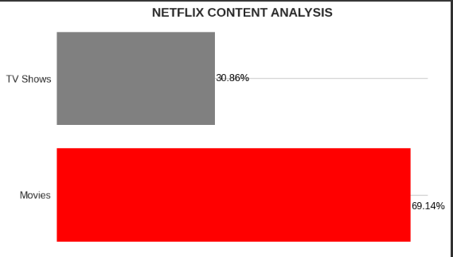
Netflix Content
Netflix contains 69% movies and 31% television shows, indicating that movie shows have more content.

Slide 11
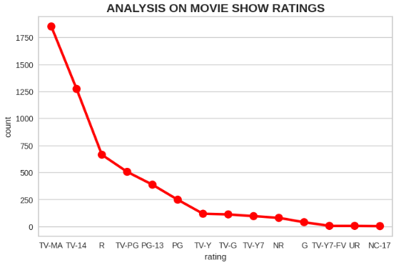
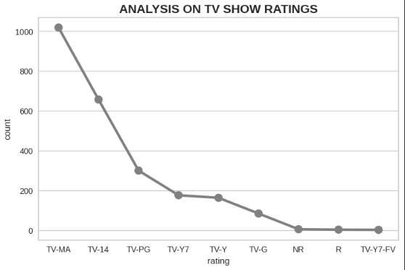
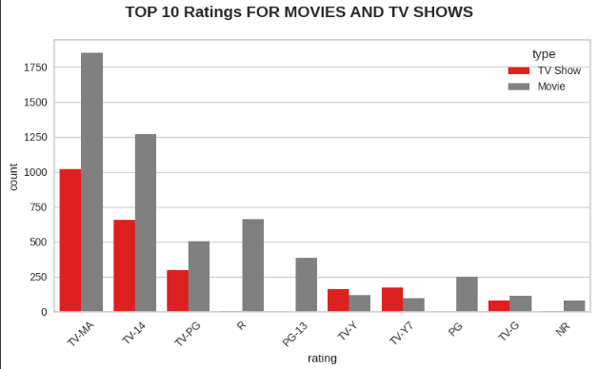
Netflix Ratings
The most common rating for movies and tv show is TV-MA, which stands for "Mature Audience," followed by TV-14, which stands for "Younger Audience." Since the number of movies is higher than the number of TV shows, as we saw earlier in the type column, movies receive the highest rating when compared to TV shows, which is pretty good.

Slide 12
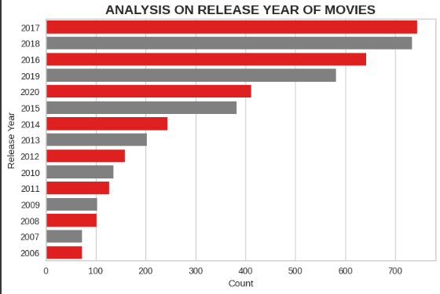
Netflix Release year
Netflix continues to add more shows on its platform over the years. Highest number of movies released in 2017 and 2018. Highest number of tv shows released in 2019 and 2020.
There is a decrease in the number of movies added in the year 2020, which might be attributed to the
covid-19-induced lockdowns, which halted the creation of shows. We have Netflix data only up to 2021, hence there are less movies added

Slide 13
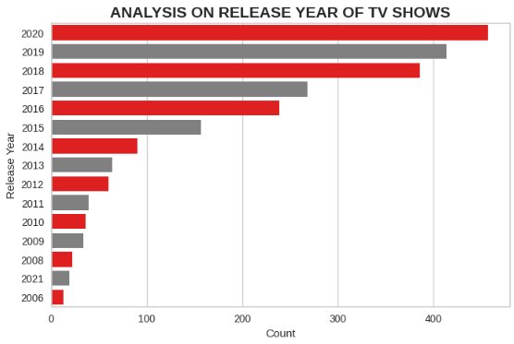
Netflix Release year
The number of movies on Netflix is growing significantly faster than the number of TV shows. It appears that Netflix has focused more attention on increasing Movie content that TV Shows. Movies have increased much more dramatically than TV shows.

Slide 14
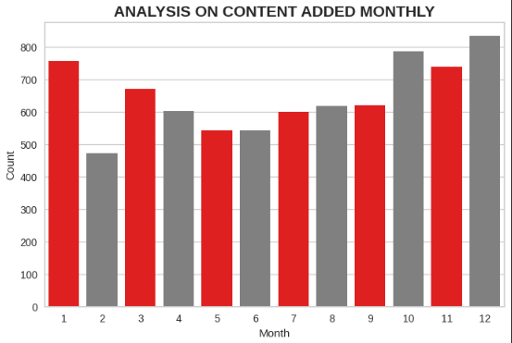
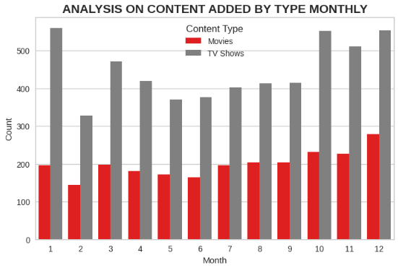
Netflix Release Month
The Christmas season (October, November, December, and January) sees a greater amount of content released. Compared to TV shows, more movies are released each month.

Slide 15
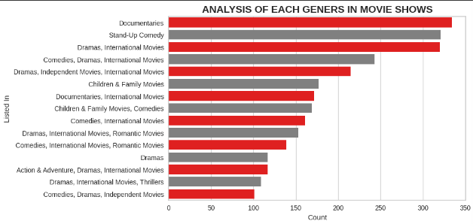
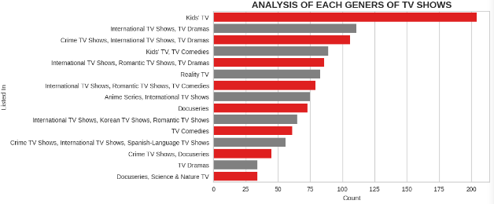
Netflix Genres
The most popular Netflix category is documentaries, which are followed by stand-up comedy, Drams, and foreign films.
The most popular Netflix TV show category is kids TV.

Slide 16
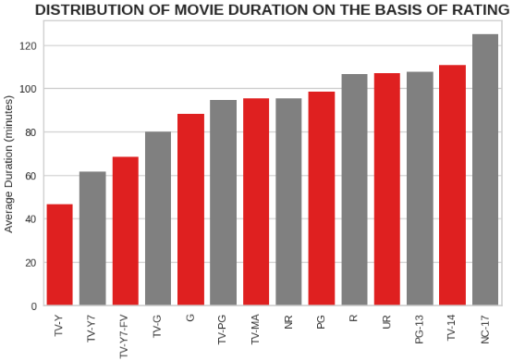
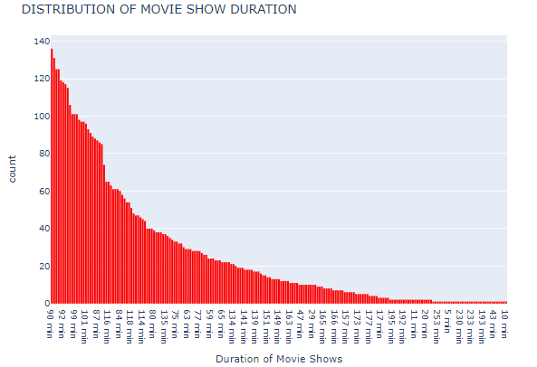
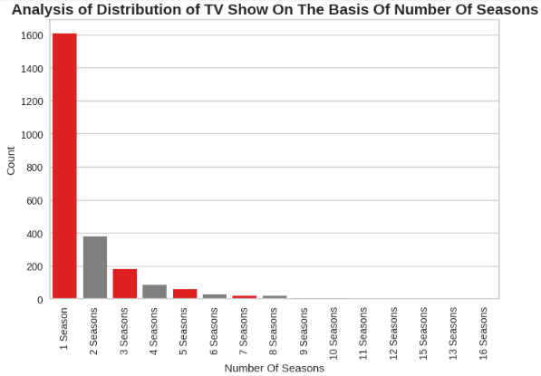
Netflix Duration
The majority of movies have a duration between 90 and 120 minutes.
The Majority of tv shows consisting of single season.
The lengthiest average runtimes are found in NC-17 rated movies(adults only like dreamers, lust and caution). The average duration of movies with a TV-Y rating(childrens of all ages like cartoons or animated films ) is the shortest.

Slide 17
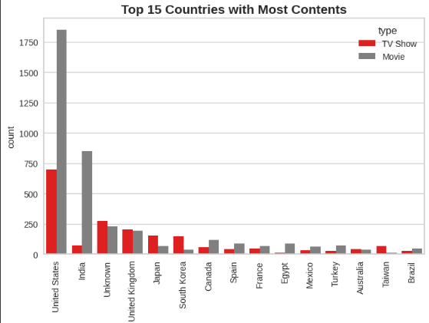
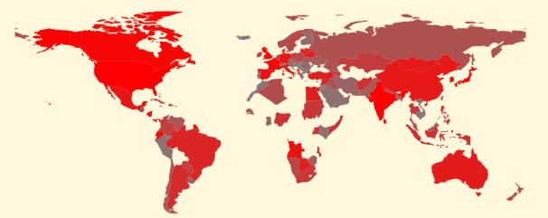
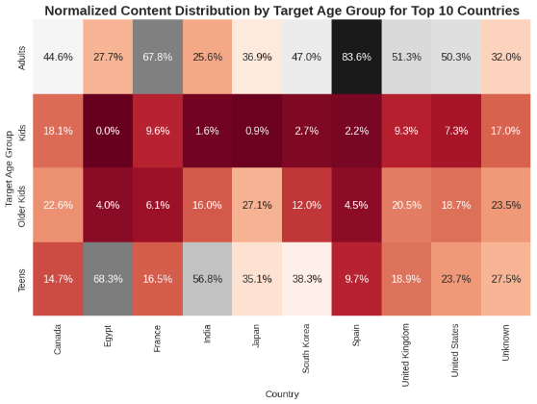
Netflix country wise
The graph visualisations show the content's country of origin, which include both Movies and TVs shows. Top of the list of nations were the US and India. A few countries, including Australia, Taiwan, and Brazil, produce little Netflix content.
From the heatmap,the US and UK are very similar to the Netflix target age group, although they differ greatly from such as India or Japan.

Slide 18
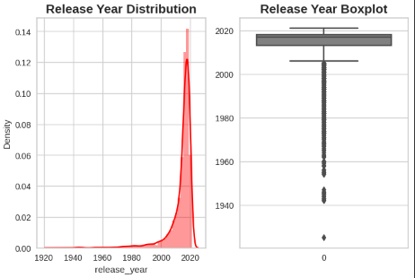
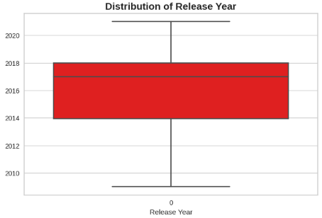
Handling Outliers
The figures (release_year less than 2009) are being displayed as outliers
Replacing outliers with mean value

Slide 19
Data Preprocessing
Modelling Approach:
Select the attributes based on which you want to cluster the shows
Text preprocessing: Remove all stopwords and punctuation marks, convert all textual data to lowercase
Lemmatization to generate a meaningful word out of corpus of words
Tokenization of corpus
Word vectorization
Dimensionality reduction
Use different algorithms to cluster the movies, obtain the optimal number of clusters using different techniques
Build an optimal number of clusters and visualise the contents of each cluster using word clouds

Slide 20
Data Preprocessing
The director, cast, country, listed_in, and description are chosen as the attributes to cluster
Removing non-ascii characters
Removing stop words and converting to lowercase
Removing punctuation marks
Lemmatization, tokenization and text vectorization

Slide 21
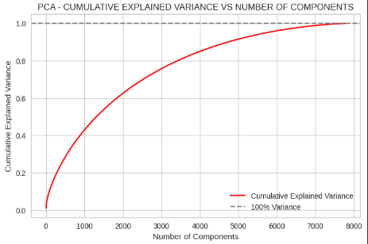
Dimensionality reduction using PCA
We find that around 7500 components account for 100% of the variance
Also, just 4000 components comprise more than 80% of the variation
As a result, we can pull the top 4000 components out of the model to make it simpler and less dimensional while still being able to account for more than 80% of variance.

Slide 22
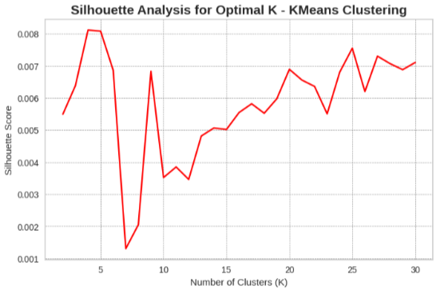
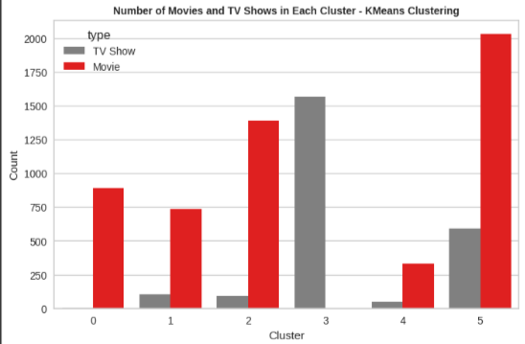
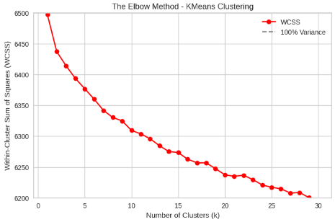
K-Means Clustering
A well-liked unsupervised machine learning method for combining comparable data points is called
K-means clustering. K-means clustering aims to divide a dataset into k clusters, each of which is represented by its centroid and contains similar data points.
Finding the ideal number of clusters for the K-means clustering algorithm requires visualising the elbow curve and Silhouette score.

Slide 23
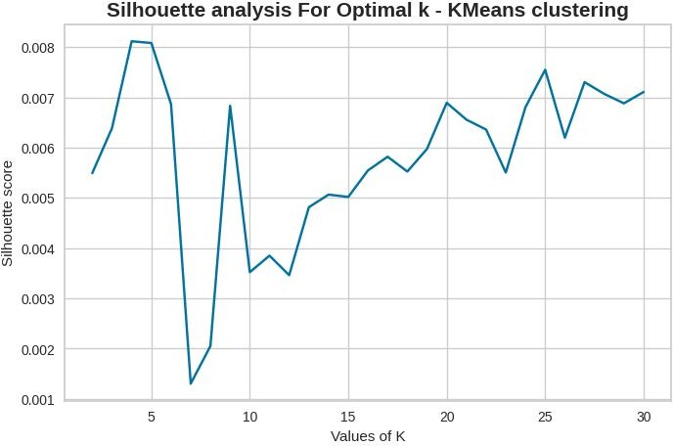
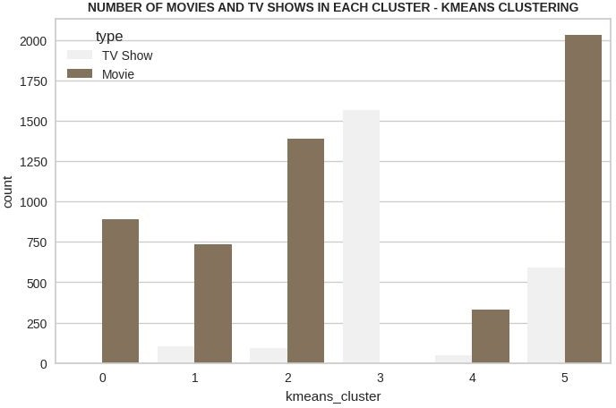
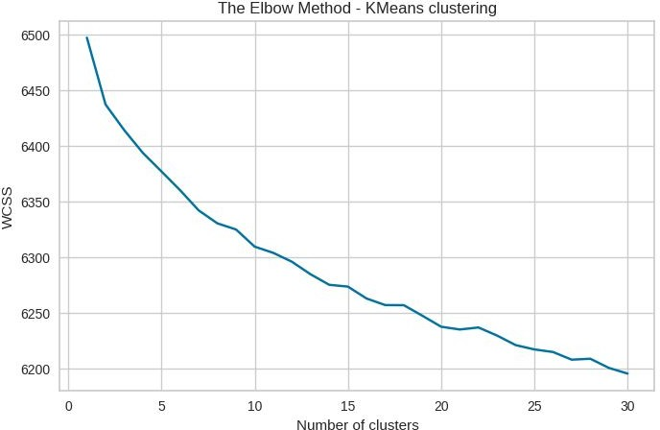
K-Means Clustering
With more clusters, there is a decrease in the sum of squared distances between each point and the centroid.
Six clusters receive the highest Silhouette score overall.

Slide 24






Word Clouds: K Means clusters
Important keywords observed in clusters

Slide 25
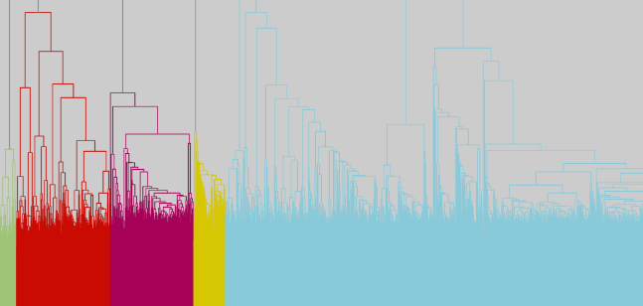
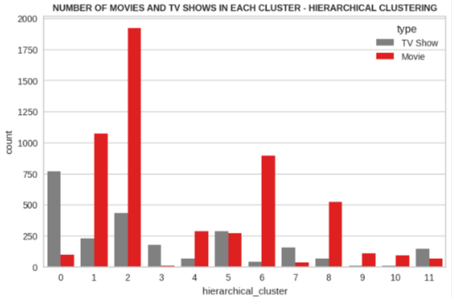
Hierarchical Clustering
The agglomerative (hierarchical) clustering process for building clusters. Using the dendrogram to visualize the agglomerative (hierarchical) clustering process to determine the ideal number of clusters.
Utilising the Agglomerative (hierarchical) clustering algorithm, 12 clusters were successfully Built

Slide 26








Word Clouds: Hierarchical clustering
Important keywords observed in clusters

Slide 27
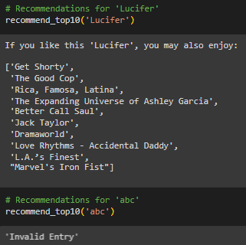
Building Content based Recommender System
The objective of a Recommender System is to recommend relevant items for users, based on their preference. If a person has watched a show on netflix, then the recommender system must be able to recommend a list of similar shows.
We have used cosine similarity to recommend top 10 movies.

Slide 28
Summary and Conclusion:
In this project, we tackled a text clustering issue where we had to categorize Netflix shows into specific clusters such that the shows within a cluster are similar to one another and the shows in different clusters are dissimilar to one another.
Once our dataset is loaded, and then we search for duplicates and missing values. No duplicate values were discovered, and any missing values were used to fill them in. In our dataset, the director column contains the most missing entries, followed by cast, country, and date_added. The string "unknown" is used to fill missing values in the director and country columns, "no cast" is used fill in the cast column, and the mode value is used to fill missing values in the rating column. the records that had null entries in the "date_added" column were deleted.

Slide 29
Summary and Conclusion:
31% of Netflix's content is television shows, while 69% of it is movie show, demonstrating that movie shows have greater content. TV-MA, which stands for "Mature Audience," is the most frequently used classification for movie and tv shows, followed by TV-14, which stands for "Younger Audience." Since the number of movie shows is higher than the number of TV shows, movie shows receive the highest rating when compared to TV shows, from this we can say people like to watch movie show than compare to tv shows.
Over the years, Netflix has added more shows to its platform. Most movies were released in 2017 and 2018. Most television shows were broadcast in 2019 and 2020. The
covid-19-induced lockdowns that stopped the production of shows may be to blame for the decline in the number of movies added in the year 2020. There are fewer movies uploaded this year because the Netflix data we have only extends through 2021.

Slide 30
Summary and Conclusion:
Netflix's movie show library is expanding much more quickly than its TV show library. It looks that Netflix has prioritised adding more movie material over TV shows. The growth of movies has been significantly more pronounced than that of TV shows.More content is released over the Christmas season (October, November, December, and January). There are more movies released each month compared to TV shows.Documentaries are the most popular Netflix category, followed by stand-up comedy, dramas, and foreign films. Kids TV is the most well-liked Netflix TV shows.
The majority of movies durations last between 90 and 120 minutes. Most tv shows have just one season. The lengthiest average runtimes are found in NC-17 rated movies. The average duration of movies with a TV-Y rating is the shortest. The geograph visualisations show that the United States and India are the two countries that produce the most content.

Slide 31
Summary and Conclusion:
The director, cast, country, genre, and description are chosen as the attributes to cluster the data based on. These attributes' values underwent tokenization, preprocessing, and vectorization using TFIDF vectorizer. A total of 20000 characteristics were produced through TFIDF vectorization. For the purpose of overcoming the dimensionality curse, we applied Principal Component Analysis (PCA). 4000 components were able to capture more than 80% of variance.
The ideal number of clusters was found to be six when we first created clusters using the
k-means clustering technique. The elbow method and Silhouette score analysis were used to get this result.The Agglomerative clustering technique was then used to create clusters, with 12 being the optimum number. The dendrogram was visualised to achieve this.The similarity matrix acquired after utilising cosine similarity was used to construct a content-based recommender system. Based on the sort of show the user viewed, this recommender system will provide them with 10 recommendations.

Slide 32

Thank You!!

